Slide 1
Simple Scheduler
Jason Santana, Matthew Pinneo, and Matthew Spitzley

Slide 2
Overview
Task List Screen
Categories
Calendar Screen
Settings
Database

Slide 3
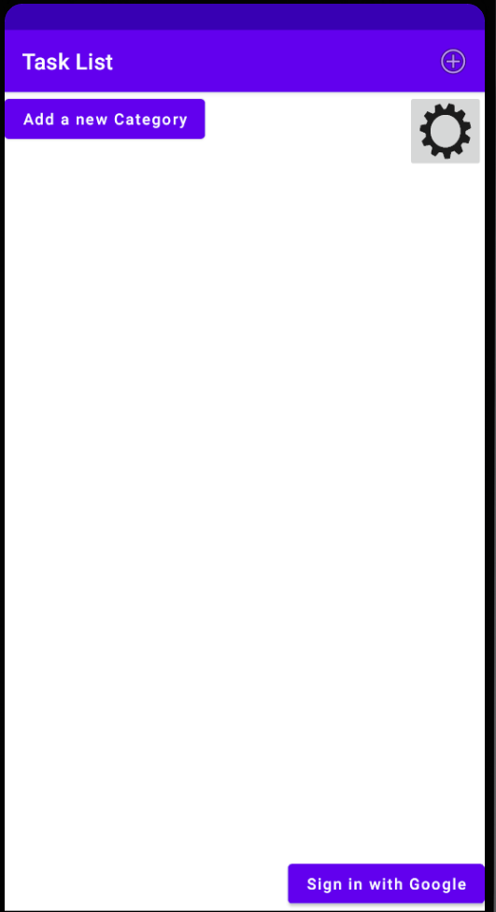
Task List Screen
-Swipe right to access Calendar Screen
-Select “Add Task” button to bring up
Add Task Menu
-Add Category
-Settings
-Google Sign-In

Slide 4
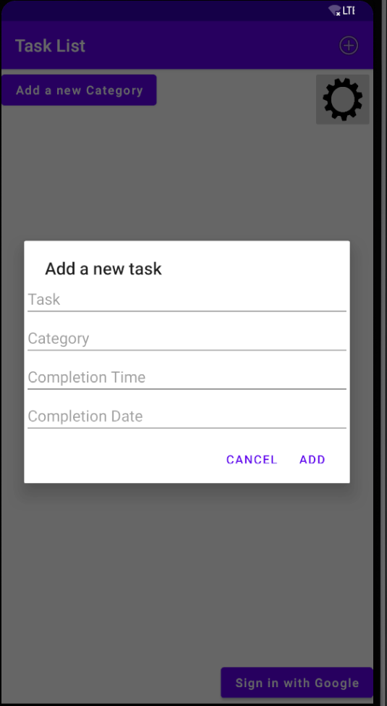
Task Add Menu
Task
Category
Time
Date

Slide 5
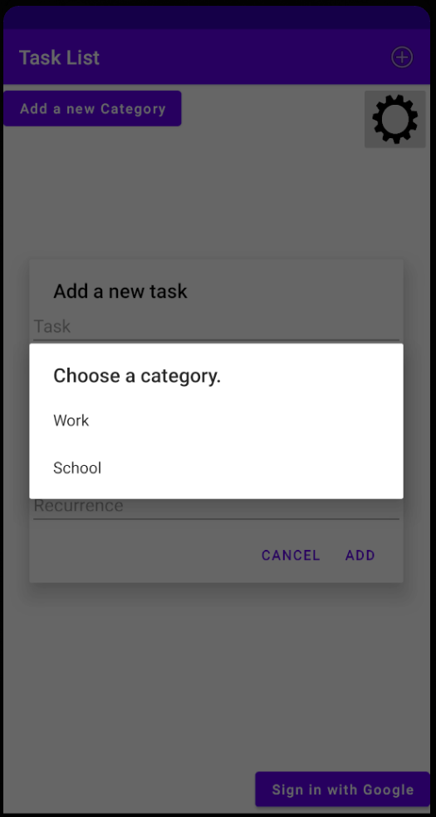
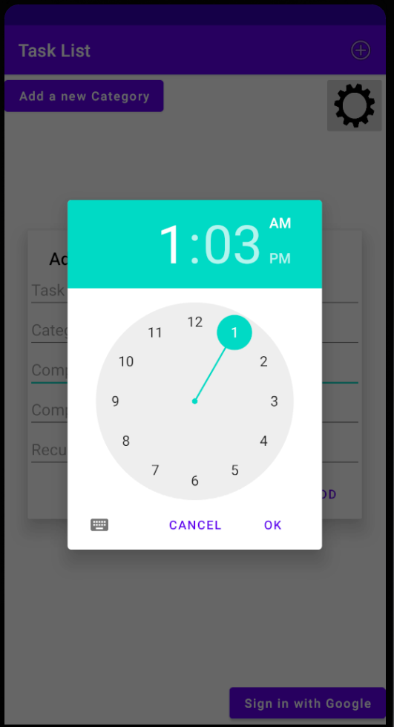
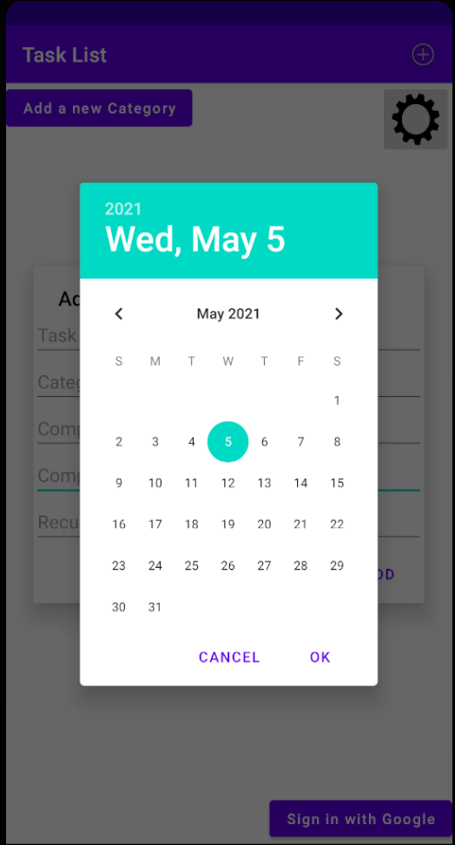
Category, Time, and Calendar

Slide 6
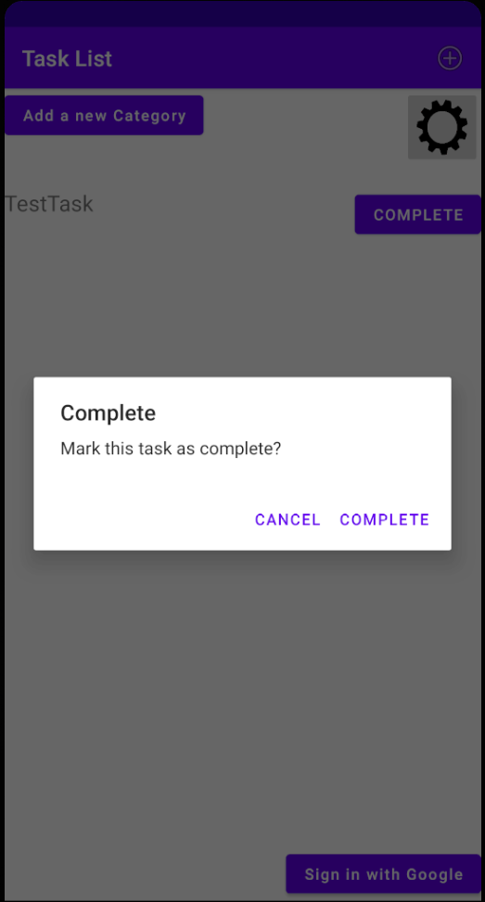
Completed Tasks
Remove tasks from list and mark as complete
Dialogue box when trying to change status to complete

Slide 7
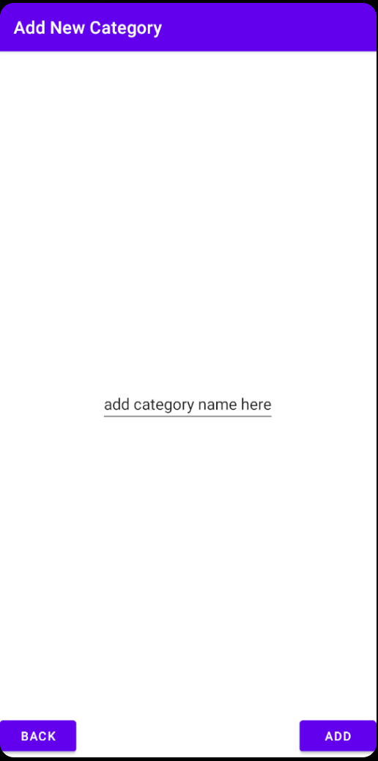
Category
-Accessible from Task List Screen
-Text Entry
-Add and back button

Slide 8
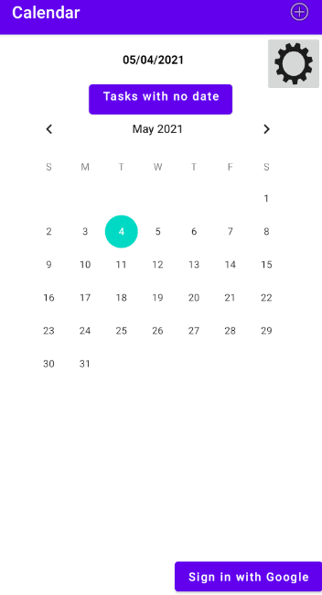
Calendar Screen
-Swipe left to access the Task List screen
-The same as the Task List screen, except it
only displays tasks for selected
dates on the calendar

Slide 9
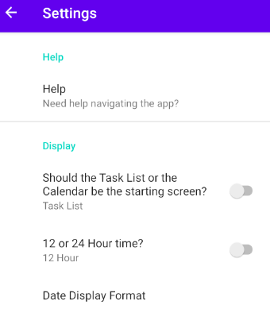
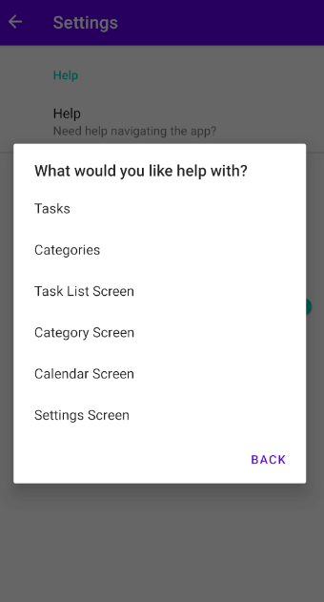
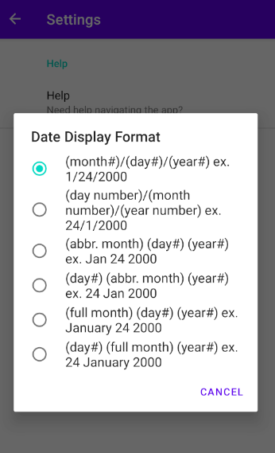
Settings pt 1

Slide 10
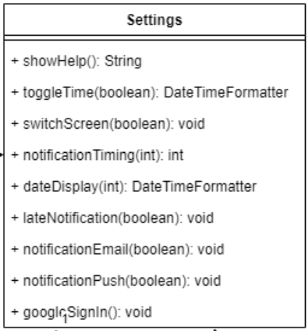
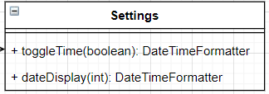
Settings p2
Before:
-Accessible from Task List and Calendar
Screens
-Shared preferences are pretty cool
-Removed Notifications
-Moved the Google sign in to
Task List and Calendar screens
After:

Slide 11
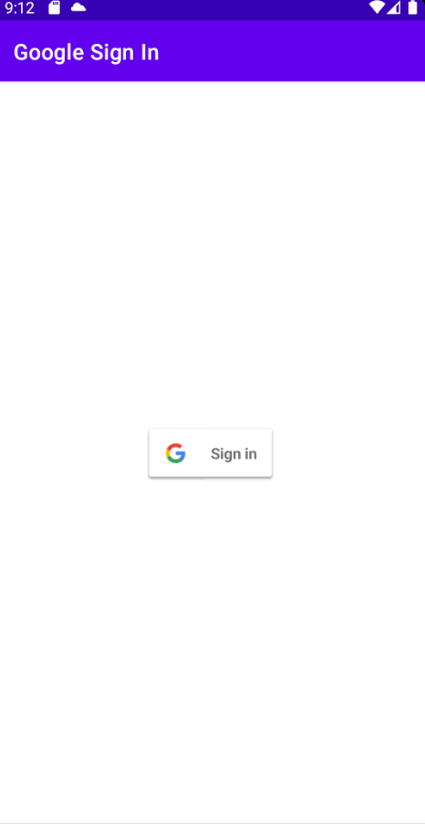
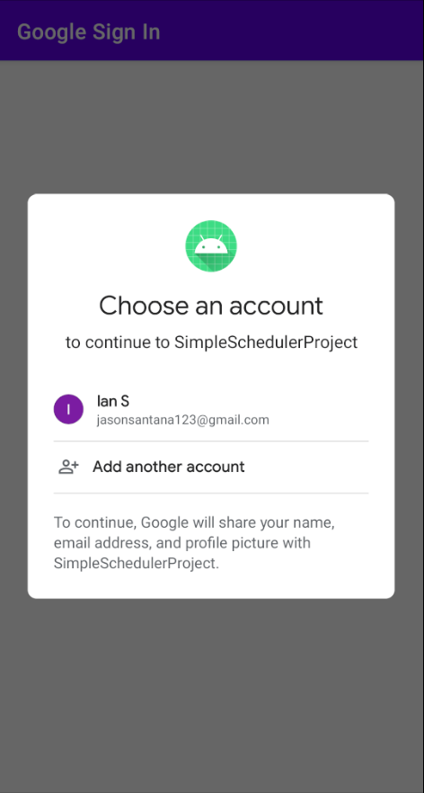
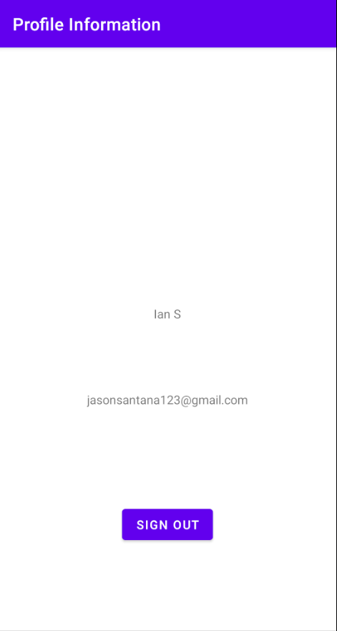
Google Sign In

Slide 12
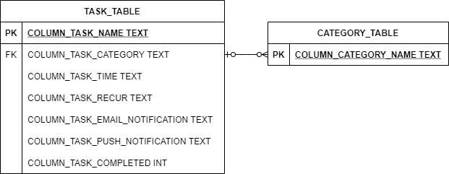
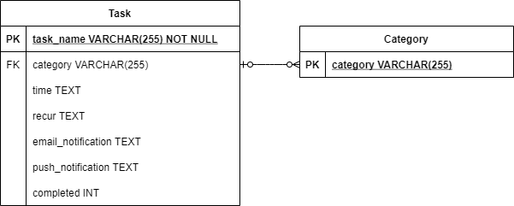
SQLite
MySQL

Slide 13
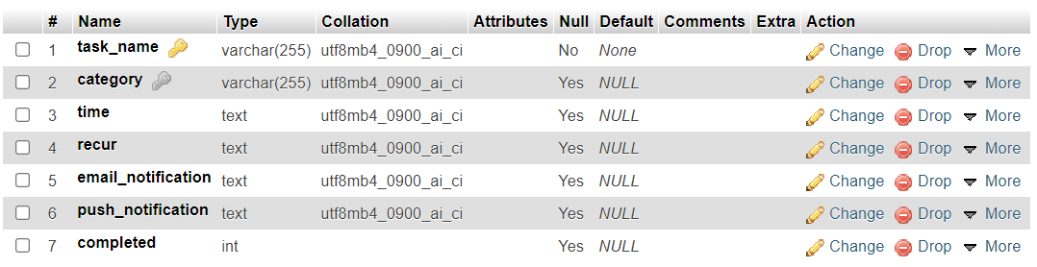
Server Database

Slide 14
Questions?

